Slide 1





Welcome to Thinking differently about recruitment.
Tuesday 7th February 2022 13:30-15:30
Housekeeping rules:
Please note that the audio and visual of this workshop will be recorded and uploaded onto YouTube.
This will be shared with other care providers and professionals.
If you have any objection, please say so at the start of the workshop
Please remember to:
  put yourselves on mute unless talking to limit background noise.
  disable your video camera.
  use the ‘raise your hand’ function if you would like to talk
  use the messaging function for any tips, questions or comments.
We will do our best to answer comments today or take them away and ensure the answers are sent out with the notes from the workshop.
Notes:
Explain the sessions are fortnightly for 1 hr and will focus on Covid related topics. We have a packed agenda but would like to hear what topics you would like to see on the agenda, which we will discuss in more detail at the end of the briefing. Add that we will be asking people to complete a short survey to capture people’s thoughts about the group and how you feel it may develop as we follow the roadmap ‘out of a Covid response’.

Slide 2
Agenda
13.30 – 13.40: Welcome, housekeeping and overview – Jon Borthwick
(WSCC CaBS)
13.40 – 13.55: Mentimeter survey – Hayley Crosby (WSPIC)
13.55 – 14.05 Setting the scene – Karen Stevens (Skills for Care)
14.05 – 14.20: How people come to work in care and why they stay –
Neil Eastwood (Care friends)
14.20 – 14.30: Compassionate leadership – Rosemary Pavoni (WSPiC)
14.30 – 14.40: Becoming the employer of choice – Neil Eastwood
14.40 – 15.00: Breakout rooms and discussion
15.00 – 15.20: Proud to Care & Champions – Jon Borthwick
15.20 – 15.30: Next steps and close

Slide 3
Mentimeter survey
Hayley Crosby
West Sussex Partners in Care
https://www.menti.com/6x6oczfw1b

Slide 4
Setting the scene
Karen Stevens
Skills for Care

Slide 5
Thinking Differently About Recruitment and Retention workshop
Karen Stevens – Locality Manager, Skills for Care karen.stevens@skillsforcare.org.uk
Notes:
Introduction

Slide 6
Making the Most of the National recruitment campaign 'Made with Care’
The DHSC has launched the latest phase of the national adult social care recruitment campaign running till March 2022
The campaign will demonstrate the amazing work care workers do, celebrating the way they empower the people they care for and shining a light on the emotional reward of the role.
Advertising will run across radio, video, on demand and digital channels with TV advertising
They will direct people to Adult Social Care to find vacancies near them.
To make the most of the campaign upload your jobs to the DWP ‘Find a Job’ platform.
Expert advice, templates and new toolkit of recruitment assets can be found in the campaign resource centre.
Notes:
NEW: NOV 2021
Adult Social Care: https://www.adultsocialcare.co.uk/home.aspx
Upload a job to DWP ‘Find a Job’ platform: https://www.adultsocialcare.co.uk/include/documents/find-a-job-instructions.pdf
Resource centre: https://www.adultsocialcare.co.uk/recruit.aspx
Campaign newsletter: https://dhsc-mail.co.uk/form/Sx1iaZDJ/zHAb6Zx4x
Next week the Department of Health and Social Care is rolling out the latest phase of the national adult social care recruitment campaign, ‘Made with Care’, which this year will run continuously until March 2022.
The campaign will demonstrate the amazing work that care workers do, celebrating the way they empower the people they care for, and shining a light on the emotional reward of the role. It’s designed to support care providers in recruiting the dedicated staff they need by inspiring people with the right values to consider a career in social care.
Advertising will be run across radio, video on demand, and digital channels, with high profile bursts of TV advertising in November and January, all directing people to Adult Social Care to find out more and search for vacancies near them.
You can make the most of the awareness the campaign will drive by running local recruitment activity at the same time and uploading your jobs to the DWP ‘Find a Job’ platform. Expert advice, templates and a new toolkit of recruitment assets will also be available from the campaign resource centre in time for the launch of the campaign.
For further updates, sign up to the campaign newsletter.

Slide 7
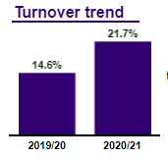
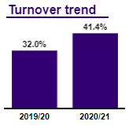
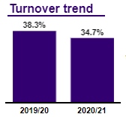
Turnover - What is it costing?
West Sussex turnover rate - 6,800 people leave their job
  If that cost £200 bring new person on board £1,360,000
  If use CIPD calculations £1500 – 10m
  If manager leave £4,500 – £1.6m
Managers Nurses Direct Care
Impact on people receiving your care & support, staff filling the gaps, agency cover, manager strain, quality, morale, reputation
Notes:
375 managers leaving

Slide 8
What works?
Research on retention
  Transform - Exeter loyalty to their employer - feeling valued, job satisfaction, having a positive impact on people’s lives, opportunity for growth, good working conditions, fair wages, flexibility and help with childcare costs.
  Secrets of Success – values based approaches, supportive induction, positive place to work, development opportunities – Retain to Gain
  Top tips for retention – A briefing for adult social care providers | Local Government Association. Recruit to retain, offer good working conditions and remove barriers to working, Understand your workforce and what motivates them, Ensure wellbeing is on everyone’s agenda, Invest in the workforce and their careers, Recognise and reward good work, ensure retention features in workforce planning
Local Recruitment Conversations – missing a trick document

Slide 9


Stay connected…
For further information or support, visit the Skills for Care website at: www.skillsforcare.org.uk
For updates, sign up to our newsletter at:
www.skillsforcare.org.uk/enews
Karen.stevens@skillsforcare.org.uk
@sfc_KarenS
@sfc_LondonSE
@skillsforcare

Slide 10
How people come to work in care and why they stay
Neil Eastwood
Care Friends

Slide 11

How people come to work in care and why they stay
Neil Eastwood
Photo by Jan Tinneberg on Unsplash

Slide 12

PUSH
Redundancy
Retirement
PULL
Persuaded by family or friend
Flexibility
Work/Life balance
Values/ calling for care
Family care experience
Career pathway
Need a job
Relocation
Unhappy at work
What PUSH and PULL reasons could lead to a care role?
Photo by Javier Allegue Barros on Unsplash

Slide 13

What was your previous occupation?
“Bouncer in night clubs”
“I have always worked in care since I was 16”
“I was a Missionary”
“Singer”
“Newcastle United footballer”

Slide 14
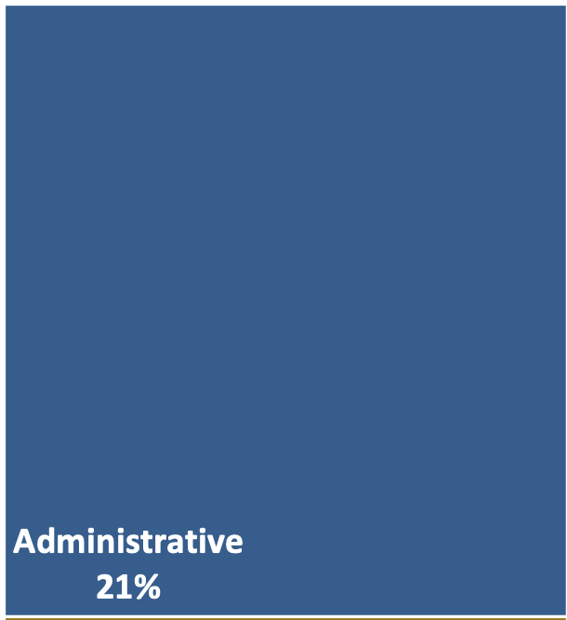
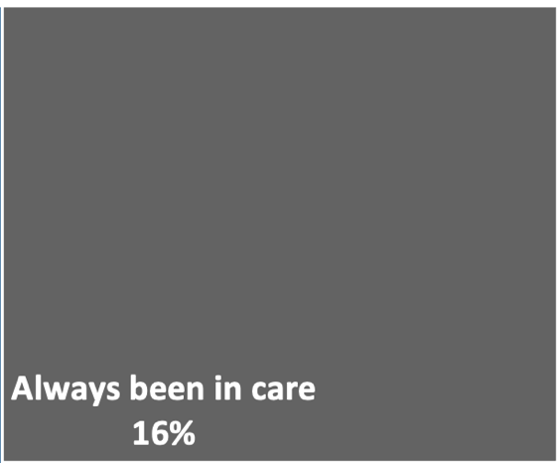




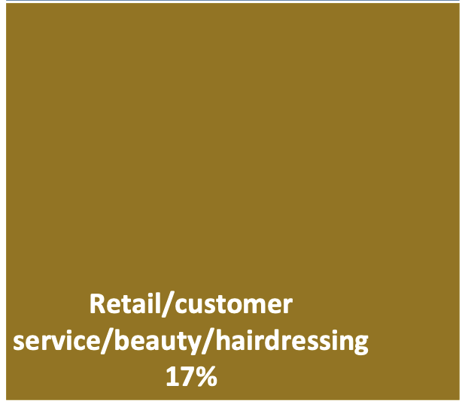
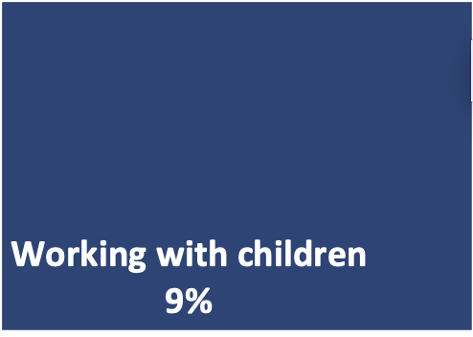
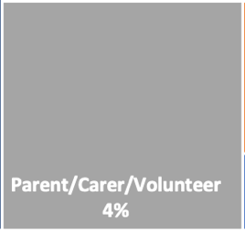



Slide 15

Any past caring experience?
34%
14%
Photo by Tim Mossholder on Unsplash

Slide 16

Target those most likely to join us
Photo by Harry Cunningham on Unsplash

Slide 17
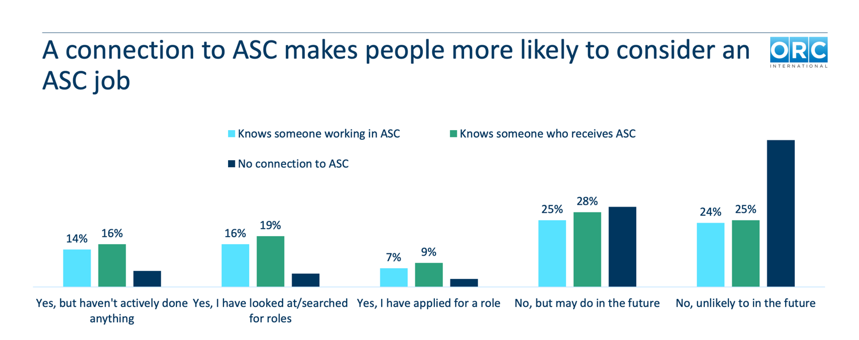

Slide 18

Why do care workers stay?
Internet job boards: 180 hours of care before termination
Employee Referral: 4,500 hours of care before termination
Photo by Anete Lūsiņa on Unsplash

Slide 19

23% say it is a turn-off,
12% cite as the main reason on exit
Are better wages the answer?
Photo by Ehimetalor Akhere Unuabona on Unsplash

Slide 20

After the intrinsic rewards, what’s left?
Photo by George Pagan III on Unsplash

Slide 21
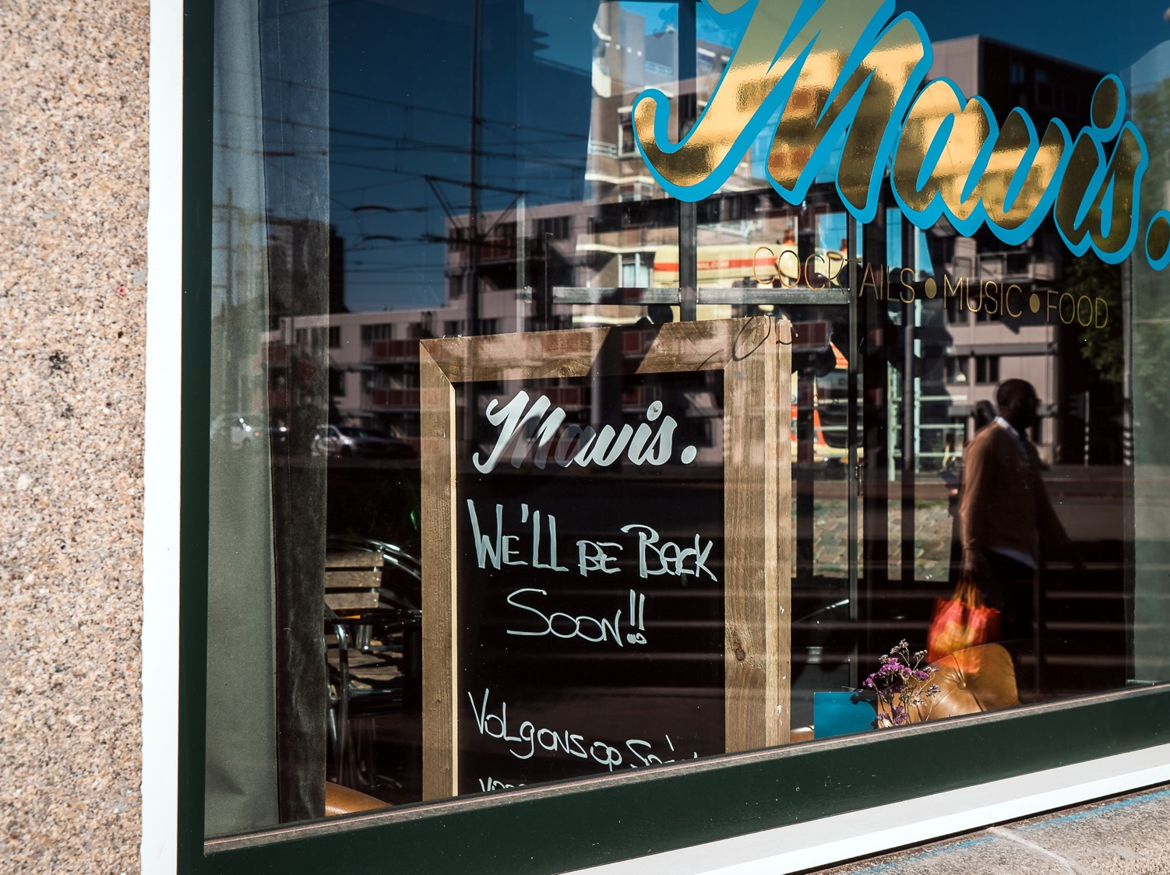
Join me later for how to be an Employer of Choice
neil@carefriends.co.uk
Photo by Ewien van Bergeijk - Kwant on Unsplash

Slide 22
Compassionate leadership
Rosemary Pavoni
Chair, West Sussex Partners in Care

Slide 23
Becoming an employer of choice
Neil Eastwood
Care Friends

Slide 24

Becoming an Employer of Choice
Neil Eastwood
Photo by Ian Schneider on Unsplash

Slide 25

Make orientation a white glove experience
Clear orientation
Boss says welcome
Peer Mentor

Slide 26

Bake in Recognition
Public praise
Letter home x1 a year
Display and share thank you letters
Recognition of service and performance

Slide 27

Signs you are an Employer of Choice
Clear Career Ladder
Ask for opinions regularly
Joint problem-solving
Soft Skills training
Regular appreciation

Slide 28

Hero of the month £15 - £35
Completing internal training £5
100% attendance £5 - £15
Covid-19 related appreciation £10+
Picking up a shift at short notice £5
Mentoring new starters £5+
Photo by Aaron Burden on Unsplash

Slide 29

neil@carefriends.co.uk
Photo by Edwin Andrade on Unsplash

Slide 30
Breakout rooms

Slide 31
Proud to Care & Recruitment Champions
Jon Borthwick
West Sussex Care and Business Support Team

Slide 32


Slide 33

Who are we?
Proud to Care West Sussex help local people find rewarding jobs in adult social care and to support care employers across West Sussex with their recruitment needs.
Proud to Care was set up in February 2019 by West Sussex County Council. We’re a small, dedicated and friendly team with vast experience of the care sector and we really know what it takes to be a fantastic care worker.
We work closely with care employers across the county, advertising their jobs on our website and offering guidance and support about all aspects of adult social care recruitment.

Slide 34
What can we do for you
Campaigns and Events
  Throughout the year we run a series of targeted campaigns and events designed to encourage more people to consider and apply for local jobs in care.
Matching Service:
  www.proudtocarewestsussex.com/job/matching/
Employer hub:
  www.proudtocarewestsussex.com/employers-hub/

Slide 35
What next?
Proud to Care have full guides available on recruitment and retention. They can be downloaded here:
Or email proudtocare@westsussex.gov.uk for to request a copy
You can also look to assign a member of staff to be a
Recruitment Champion!

Slide 36
Recruitment Champions
This doesn’t need to be a senior member of staff just someone with a interest in supporting people, interested in learning new skills, patient and invested in improving your workforce.
Recruitment Champions can help with things like:
Sorting through applications
Calling candidate to pre-screen them before offering interview
Writing and posting job adverts
Being a buddy for new starters
Organising initiatives like employee of the month
Having a recruitment champion will not only save you time but help with the personal development of one of your members of staff which will help with your retention

Slide 37
Information used from:
https://www.skillsforcare.org.uk/adult-social-care-workforce-data/Workforce-intelligence/publications/Topics/Recruitment-and-retention.aspx
https://www.ncfe.org.uk/all-articles/recruitment-and-retention-challenges-within-the-adult-social-care-sector/
https://www.nhs.uk/live-well/
https://www.brighthr.com/articles/culture-and-performance/staff-turnover/employee-turnover-costs/

Slide 38
Just before we go…
What parts of the workshop did you find most useful?
What parts of the workshop did you find least useful?
What will you take away from today?
Please complete our short survey here:
https://forms.gle/rCBmedF8YMrBnh4t5

Slide 39
Thanks for coming!

